Slide 1
Exploring Chinese Restaurant Market in New York City

Slide 2
Introduction and Objective
New York metropolitan area is home to the largest and most prominent ethnic Chinese population outside of Asia. The Chinese American population of the New York City metropolitan area was an estimated 893,697 as of 2017. New York City itself contains by far the highest ethnic Chinese population of any individual city outside Asia, estimated at 628,763 as of 2017.
The objective of this project is to understand the number of chinese restaurants in each borough in New York and see if there is scope for me opening a new chinese restaurant in the area. The key measures will be understanding the number of chinese restaurants in the area and also their average rating so that we have a good understanding of both in order to make my decision.

Slide 3
Data Overview
New York city Borough and Neghbourhood data source : https://cocl.us/new_york_dataset
This data will be used to explore various neighborhoods of new york city.
Chinese resturants in each neighborhood of new york city will be sourced from foursqaure API. We will be able to get all chinese restaurants by borough using this source.

Slide 4
Approach
Describe the main attributes of the product
Link the product attributes to customer needs

Slide 5
Overview of Boroughs and Chinese Restaurants
There are 5 Boroughs in New York
There are 306 Neighborhoods in New York.
There a total of 429 Chinese Restaurants in New York

Slide 6
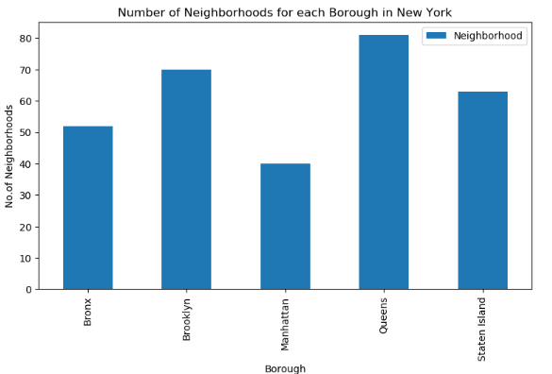
Queens has greatest number of neighborhoods
Queens has the most neighborhoods in New York.
This is followed by Brooklyn
We may expect that we have the most chinese restaurants in Queens based on number of neighborhoods

Slide 7
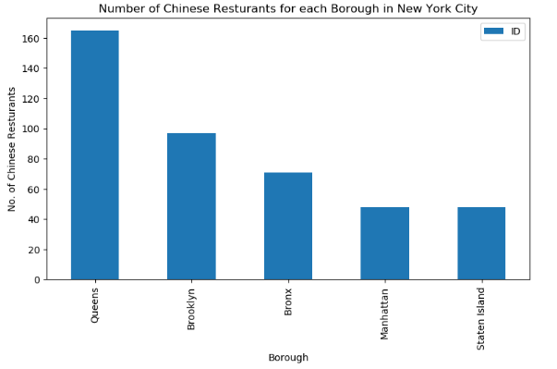
Queens has the most chinese restaurants
Queens has the highest number of chinese restaurants.
This aligns with the number of neighborhoods in queens, which was ranked as the highest.

Slide 8
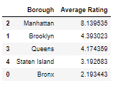
Average Chinese Restaurant Rating by Borough
Manhattan Chinese Restaurants are rated the best on average.
Queens has the most restaurants but they are rated only third best on average.

Slide 9
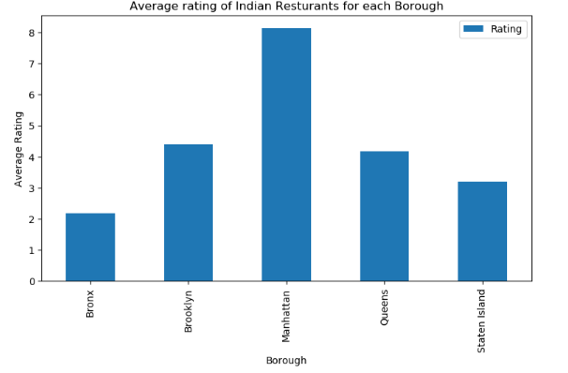
Manhattan best rating for all Boroughs
Manhattan Chinese Restaurants are rated the best on average.
Brooklyn just above Queens in terms of rating.

Slide 10
Conclusion
Queens has the most chinese restuarants but rated only 3rd best Borough.
Manhattan have the best Chinese restaurants on average based on rating.
Brooklyn has the second best rated chinese restaurants on average.
I would consider opening a restaurant in Queens even though there are many restaurants there. I may gain an advantage by opening a quality restaurants with good service and food since ratings on average in queens for existing restaurants are not great.

